Slide 1



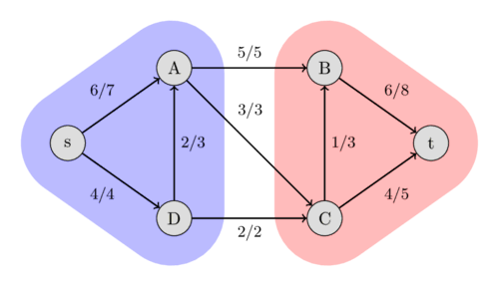
DESIGN AND ANALYSIS OF ALGORITHMS
STUDY AND ANALYSIS OF FORD FULKERSON ALGORITHM
Ajinkya Walunj (12110283)
Akash Bhandari(12111450)
Aneesh Dighe(12110353)
Anish Sagri(12110206)
Faculty: Dr. Pushkar Joglekar

Slide 2
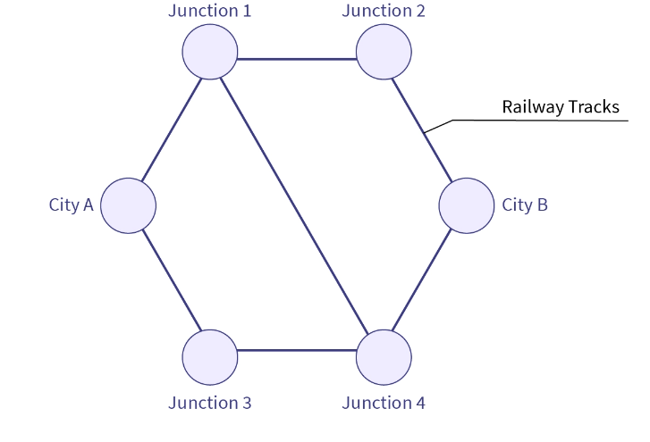
INTRODUCTION
The Ford–Fulkerson method or Ford–Fulkerson algorithm (FFA) is a greedy algorithm that computes the maximum flow in a flow network.
We have implemented Edmond-Karps algorithm of the FFA for efficiently allocating resources and determining the maximum flow in network systems, from transportation to computer networks.
Further we have performed the comparison of time complexities and space complexities

Slide 3


TERMINOLOGIES
Flow Network -A directed graph where each edge has a capacity that represents the maximum flow it can carry.
Source: The node from which the flow originates in the network.
Sink: The node that is the final destination of the flow in the network.
Residual Capacity: The remaining capacity of an edge in the context of the flow. It represents how much more flow can be pushed through an edge.
Residual Graph: A representation of the remaining capacity of edges in the network. It helps in finding augmenting paths.
Augmenting Path: A path from the source to the sink in the residual graph, which signifies the potential for increasing the flow.
Flow Augmentation: The process of adjusting the flow in the network, typically along an augmenting path, to increase the overall flow from the source to the sink.
Maximum Flow: The maximum amount of flow that can be sent from the source to the sink in the network, as determined by the Ford-Fulkerson algorithm.
Residual Network: A representation of the network that shows the remaining capacity for each edge after the flow has been determined.

Slide 4
Algorithm
Start with initial flow as 0.
While there exists an augmenting path from the source to the sink:
Find an augmenting path using any path-finding algorithm, such as breadth-first search or depth-first search.
Determine the amount of flow that can be sent along the augmenting path, which is the minimum residual capacity along the edges of the path.
Increase the flow along the augmenting path by the determined amount
3. Return the maximum flow.

Slide 5
One crucial aspect of the algorithm is the choice of how to find the augmenting paths, which can significantly affect its efficiency and performance.
In the original Ford-Fulkerson algorithm, augmenting paths can be found using a depth-first search. This approach doesn't guarantee that the chosen augmenting paths are the shortest, which can lead to inefficiencies.
The Edmonds-Karp algorithm, on the other hand, addresses the inefficiencies of the Ford-Fulkerson algorithm by utilizing a breadth-first search. This guarantees that the shortest augmenting path is always selected.
By using BFS, the algorithm ensures that the augmenting paths found are the shortest in terms of the number of edges, leading to a more efficient approach for finding augmenting paths.

Slide 6
Pseudo Code
flow = 0
for each edge (u, v) in G:
flow(u, v) = 0
while there is a path, p, from s -> t in residual network G_f:
residual_capacity(p) = min(residual_capacity(u, v) : for (u, v) in p)
flow = flow + residual_capacity(p)
for each edge (u, v) in p:
if (u, v) is a forward edge:
flow(u, v) = flow(u, v) + residual_capacity(p)
else:
flow(u, v) = flow(u, v) - residual_capacity(p)
return flow

Slide 7
Ford-Fulkerson Algorithm
Time complexity:
O(max_flow*E)
Space Complexity:
O(V^2)

Slide 8

Edmonds-Karp Algorithm:
Time Complexity: O(V*E^2)
Space Complexity: O(E+V)
V-Vertices
E-Edges

Slide 9
Applications
Optimizing goods transport in logistics.
Efficient data flow in telecommunications.
Optimizing data routing in computer networks.
Defining boundaries in image segmentation.
Optimizing substance flow in biomedical networks.

Slide 10
Thank You

